Slide 1
Search
Name
Title
Company

Slide 2
Agenda
Search Overview
Executing Queries
Search Verticals
Parsers
Custom Entity Extraction
Web Service Call-out

Slide 3
Search Overview

Slide 4
Overview
Search in SharePoint 2010
 | SharePoint Search | FAST Search
Focus | Enterprise search | Search application platform
Strengths | Ease of deployment, low TCO | Scale, Extensibility
Limitations | Limited extensibility | Complex deployment, maintenance
Products | SharePoint Foundation, SharePoint Server, Search Server | FAST Search for SharePoint, FAST Search for Internet Sites
Notes:
Just a reminder of what products we had in SharePoint 2010

Slide 5
Search in SharePoint 2013
Single Extensible Platform
FAST Engine
SharePoint Crawler
Best of both!
Same Search Platform in both SharePoint and Exchange
Notes:
The point here is that the search products are all unified under a single search product

Slide 6
Overview
Search Architecture
Enterprise Search
PARTNERS
CUSTOMER
My Tasks (Proj)
Content by Search
People Search
Topic Pages
Site Search
Video Search
EXTENSIBLE Search Platform
Notes:
These are all the different things you can do with search
Enterprise, People, and Site search are all OOB things that people are familiar with
Topic Pages and Content by Search are new WCM features that allow for search-driven sites
My Tasks is in Project
MySite in the SharePoint Workspace
Customers and Partners will extend the platform

Slide 7


Search architecture
HTTP
Enterprise Search Portal
File Shares
Web Service Callout
Query Engine
Query Pipeline
REST Service
Client Framework
Client-Side OM
SharePoint Sites and Portals
SharePoint
User Profiles
IMS Runtime
SharePoint topic and content pages
Crawl and Connectors
Content Pipeline
Indexing Engine
Exchange
SharePoint Sites and Portals
Lotus Notes
CTS Runtime
Analyzer
SharePoint Sites and Portals
Documentum
Custom
Custom non-SP Search Driven Apps
Notes:
FAST really didn't crawl, it allowed push into index (Content API), while SharePoint crawled
In SharePoint 2013, the Content API is out. Now the crawler runs continuously. Continuous focuses on a small number of things to be efficient.
Continuous crawl is for the SharePoint index only and makes use of the change log to pick up changes.
Continuous crawls run in parallel and do not wait for previous threads to complete so it updates quickly
Continuous crawls do not retry errors from previous crawls, incremental is used for that
Security changes are included
Full and Incremental crawls still exist, they would be used:
Full is still required under the same conditions as SharePoint 2010
(http://technet.microsoft.com/en-us/library/cc262794(office.12).aspx)
Incremental is required for security changes
Continuous for changes noticeable by end users
Don't really need a dedicated server for continuous, but you could. Depends on resource usage.
Managed Properties – Still exist. Can create a site columns and have a managed property created. Administer at the Site Collection level. On-line you can do it at the tenant admin level.
Architecture
Crawl and Connectors - .NET Assembly Connectors and Parsers. Allows for connection to a system and crawling a system
Content Pipeline – just the functionality of bringing content in through crawl.
Web Service Callout – Synchronous call to a web service for additional content processing
CTS Runtime – processes contents. No real extensibility story.
Analyzer - Process user behavior (click analysis). Supports things like recommendations based on behavior. There is an extensibility story for that.
Indexing Engine – Indexes content
Query Engine – executes queries
Query Pipeline – just the functionality for processing queries.
IMS Runtime – processes queries. No real extensibility story.
REST Service – Execute queries through REST
Client Framework – Execute queries through CSOM

Slide 8
Export and Import Search Settings
CSOM API
Allows targeting export and import of search settings
Handles rules, sources, managed properties, etc
Does not handle master pages, templates, and web parts
Supports migrations, DEV->QA->PROD scenarios

Slide 9
Executing Queries

Slide 10
Executing Queries: Query Languages
Keyword Query Syntax
Preferred method
FAST Query Language
Still available
SQL Query
Removed from the Product
Notes:
KQL – All the basics. Simpler syntax. Now supports proximity queries like “NEAR”. The point is that KQL is really the language to use.

Slide 11
Executing Queries: KQL
Searching For… | Keyword | Example | Description
General | Text | Training | Search for items containing “Training”
 | Wildcard | Train* | Search for items like “Training” and “Trainer”
 | Phrase | “Training Room” | Search for the exact phrase
Documents | IsDocument | Training IsDocument:1 | Returns documents containing “Training”
 | FileExtension | Training FileExtension:docx | Returns Word documents containing “Training”
 | Author | Author:Cox IsDocument:1 | Returns documents authored by “Cox”
 | Title | Title:Training IsDocument:1 | Returns documents with “Training” in the title
People | Lastname | Lastname:C | Returns all people whose last name starts with “C”
Tasks | contentClass | contentClass:STS_ListItem_Tasks | Returns all task items
Events | contentClass | contentClass:STS_ListItem_Events | Returns all calendar events
Notes:
KQL – All the basics. Simpler syntax. Now supports proximity queries like “NEAR”. The point is that KQL is really the language to use.

Slide 12
Executing Queries: REST
Keywords
http://server/site/_api/search/query?querytext='{KQL Query}‘
Selecting Properties
http://server/site/_api/search/query?querytext='test'&selectproperties='Title,Rank'
Sorting
http://server/site/_api/search/query?querytext='test'&sortlist='LastModifiedTime:descending'
http://server/site/_api/search/query?querytext='test'&sortlist='LastModifiedTime:descending,Rank:ascending'
Notes:
REST interface allows for querying
Permissions
Scope: http://sharepoint/search
Right: QueryAsUserIgnoreAppPrincipal

Slide 13
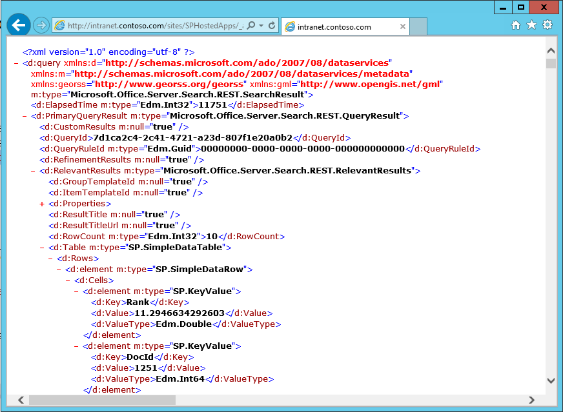
Executing Queries: REST
/_api/search/query?querytext='Argument'
Notes:
REST interface allows for queries

Slide 14
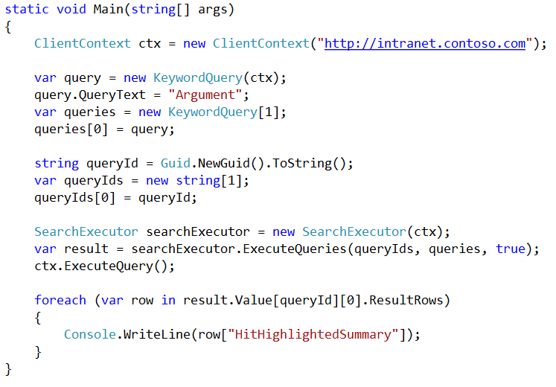
Executing Queries: CSOM

Slide 15
Creating a Search App
demo

Slide 16
Search Verticals

Slide 17
Search Verticals: No-Code Customization
Result Sources
Analogous to a Federated location in SharePoint 2010
Query Rules
Allow for the customization of returned results
Result Types
Determines how to display a set of results
SPNavigation Provider
Replaces the tabs in previous versions of Search Center
Notes:
Result Sources
With search result sources, you can give users the ability to simultaneously search content in the search index of the local search service, as well as in other sources, such as internet search engines. In SharePoint Server 2010, these were known as federated locations.
Query Rules
Query rules let you customize the search experience for the kinds of queries that are important to your users, without any custom coding. For example, if your users frequently search for PowerPoint slides, you can use query rules to recognize these queries by tracking keywords such as "slides" or "ppt", or by learning the queries where users commonly click on PowerPoint files in the results. Then, when the user performs these queries, you can do any of the following:
• Return a special result linking to a search vertical customized for displaying PowerPoint files.
• Show a block of results with only PowerPoint files.
• Change the search results so that PowerPoint files are ranked higher in the results.
Result Types
Result types define how to display a set of search results based on a collection of the following:
Rules Determines when to apply a result type, based on the specified conditions. Rule conditions can be joined together by using equality, comparison, and logical operators.
Properties Determines the list of managed properties for the result. You must add managed properties to the list before you map it to a display template.
Display templates Defines the visual layout of the result type.

Slide 18
Search Verticals: Result Sources
Select a Source
Local SharePoint Index
Remote SharePoint Index
OpenSearch
Exchange
Apply a Query Transformation
{searchTerms} contentclass:sts_listItem_genericlist
path:http://contososerver/searchsamples/Lists/Glossary
Notes:
Result Sources allow you to use Federated Locations as a source, but utilize a Query Transformation to narrow the search against the source. You can search something very narrow, like a list, or broad like a site collection.

Slide 19
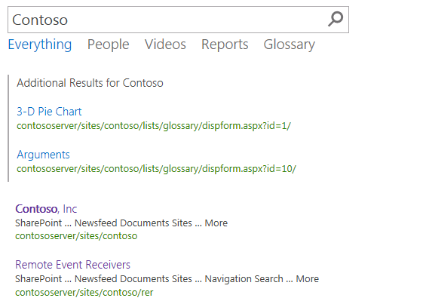
Search Verticals: Query Rules
Applied to a Result Source
Processed under given conditions
Keyword Query matches
Topic Category
Result Types
Result Blocks

Slide 20
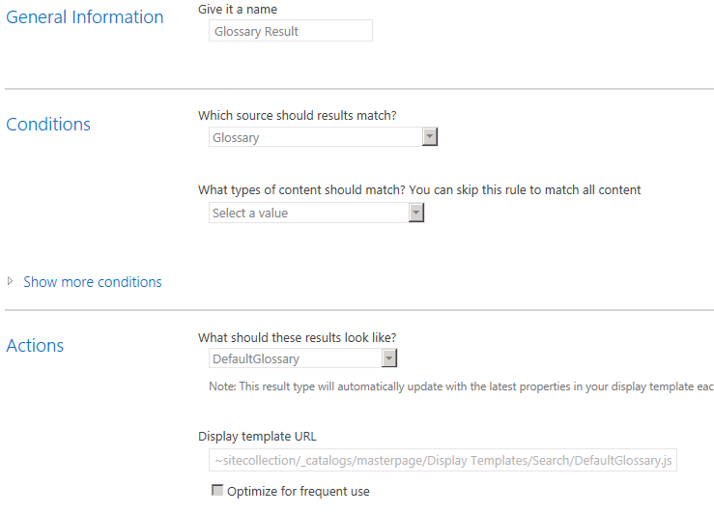
Search Verticals: Result Types
Bound to a Result Source
Defined by a Rule
Associated with a Template

Slide 21
Search Verticals: Display Templates
Determines how Result Types appear
Created as an HTML file with special references to the Managed Metadata properties
<div id="Header">
_#= ctx.CurrentItem.owsqTXTTextProduct =#_
</div>

Slide 22
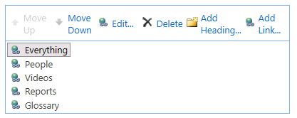
Search Verticals: Search Navigation
Utilizes the SPNavigation Provider
Search Center > Site Settings > Search Settings

Slide 23
Search Verticals
demo

Slide 24
Parsers

Slide 25
Parsers
Parser Engine detects document format
Many formats supported OOB
Calls appropriate Format Handler
Format Handlers perform actual parsing
Custom Format Handlers implement IFormatHandler
Notes:
The indexer needs a way to access a system and parse the contents it finds there.
Accessing systems is accomplished by .NET Assembly Connectors
Parsing the contents is handled by “Parsers” and “Format Handlers”. Parsers detect the document format (and do not rely on the document extension). They then call the appropriate Format Handler to parse the document.

Slide 26
Parsers
New parsing features
Automatic file format detection
Deep link extraction for Word and PowerPoint formats
Visual meta-data extraction: titles, authors and dates
High-performance format handlers for HTML, DOCX, PPTX, TXT, Image; XML and PDF formats
IFilter API still supported
Allows support for file formats that do not have format handlers
New Montage, Visio and OneNote IFilters
Notes:
Automatic File Format Detection
OOB, Parsers can actually detect more formats than are supported by the available format handlers. For this reason, the IFilter API is still supported. The Ifilter can call a generic Format Handler to plug into the parsing architecture.
Deep Link Extraction
Deep Link extraction means that anything in the document formatted as a header (or slide title) is pulled out and displayed as a link in the hover panel. This allows you to preview the paragraph (or slide) that is most relevant to your search.
Visual Metadata Extraction
Extracts the title, author, and date based on the document and not the metadata because the metadata is often wrong

Slide 27
Parsers
Format Handlers and IFilters
Format Detectors
Formats
IFilters
Format Handlers
Html Format Detector
htm
Html Format Handler
html
Pdf Format Handler
PDF Format Detector
pdf
Visio Format Detector
vds
Visio IFilter
Generic IFilter Format Handler
One Note Format Detector
one
One Note IFilter
vesku
Vesku Format Handler
docx
Office 2003 Word Processor IFilter
Word Processor Ifilter Format Handler
Office 2003 Format Detector
dotx
xlsx
Office 2003 spreadsheet IFilter
Spreadsheet Ifilter Format Handler
Notes:
This shows how the parsers can detect formats that have a format handler and ones that do not. Ifilters are used where there is no specific format handler.

Slide 28
Web Service Call-Out

Slide 29
Web Service Call-Out
Transform managed properties using a custom web service
Data cleansing
Entity extraction
Classification and tagging
SOAP web service
Reads a set of managed properties and returns new or modified properties
Content Processing web service client
Trigger conditition controls when to do (synchronous) call-out
New or modified managed property values get indexed
Configurable error handling: Warn or Fail document
Notes:
Content Pipeline is the one place where you have access to all of the searched items before the index gets created.
Web service allows you to modify managed property values or add new properties
Example: You can add additional information like a rating from a web service that’s not part of the metadata information normally.
Data Cleansing: You can use this to normalize data like making «MSFT» or «Microsoft» into «Microsoft Corporation» by changing the value of a managed property
Entity Extraction: Allows for adding managed properties to a document that didn’t exist before based on values in the body of the document
Classification and Tagging: Allows for adding managed properties to a document that didn’t exist before based on classification rules
The web service client is configured with:
SOAP RPC endpoint
- Implements a well-defined interface
Optional SSL transport security
Trigger condition: checks existence/values of managed properties before doing call-out (allows for rules that determine when the callout happens)
Input managed properties: set of managed properties to send to web service, includes read-only managed properties
Output managed properties: set of managed properties returned from web service, can not include read-only properties
Failure mode: if web service generates error, either log warning and index document OR fail document and return error code to crawler
There are size limits for each property returned from the web service + a total size for the message.

Slide 30







Web Service Call-Out – Data Flow
SOAP RPC Web Service
Input MPs
Output MPs
Content Processing
Crawler
TriggerCondition = True
Crawler Flow
Search Index
Farm Admin
Admin Database
Trigger expression
Input Managed Properties (MPs)
Output MPs
Failure Mode
 | No errors | Errors
Failure Mode = error | New MP values get indexed | Item not indexed (see crawl log for errors)
Failure Mode = Warning | New MP vlaues get indexed | Item gets indexed without new MP vlaues
Configure schema
Configure web service client
Start Crawl
Notes:
Farm Admin sets up the rules for triggering and the endpoint to call
Remember, managed properties must exist before the crawl starts or the callout will return errors
You can only have a single callout in the engine.

Slide 31
IContentProcessingEnrichmentService Interface
ProcessedItem ProcessItem(Item item)
ProcessItemResponse(ProcessedItem ProcessedItemResult )
ProcessedItem
Int ErrorCode
ArrayOfProperty ItemProperties
Item
ArrayOfProperty
ArrayOfProperty
0 or more Property
Property types
xs:string StringProperty
xs: IntegerProperty
xs:Boolean BoolProperty
xs:long LongProperty
xs:base64binary BinaryProperty
xs:double DoubleProperty
xs:dateTime DateTimeProperty
xs:decimal DecimalProperty
ser:guid GuidProperty
ListProperty
List of single type properties

Slide 32
Summary
Search Overview
Executing Queries
Search Verticals
Parsers
Custom Entity Extraction
Web Service Call-out

Slide 33

© 2012 Microsoft Corporation. All rights reserved. Microsoft, Windows, Windows Vista and other product names are or may be registered trademarks and/or trademarks in the U.S. and/or other countries.
The information herein is for informational purposes only and represents the current view of Microsoft Corporation as of the date of this presentation. Because Microsoft must respond to changing market conditions, it should not be interpreted to be a commitment on the part of Microsoft, and Microsoft cannot guarantee the accuracy of any information provided after the date of this presentation. MICROSOFT MAKES NO WARRANTIES, EXPRESS, IMPLIED OR STATUTORY, AS TO THE INFORMATION IN THIS PRESENTATION.

